Slide 1
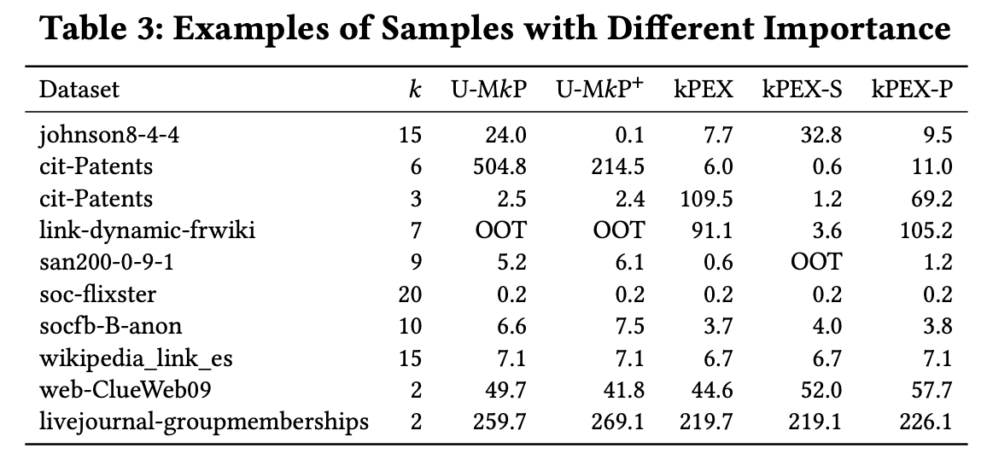
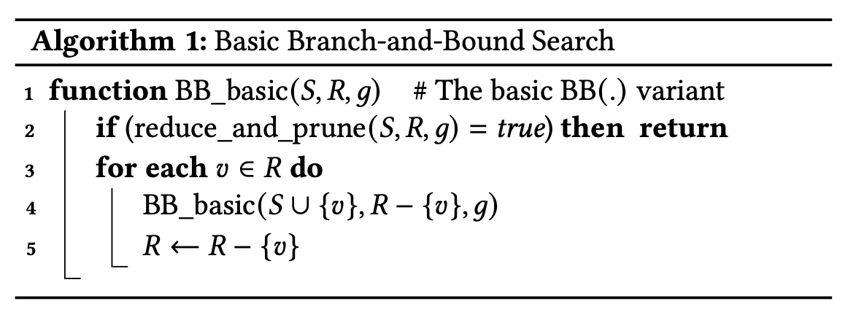
No. of rec calls
UMKP | UMKP+ |  | No. of branches AltRB pruned
3,100,274 | 1902 |  | 310
384,356 | 205 |  | 47
48,028 | 73 |  | 22
5434 | 160 |  | 26
916 | 41 |  | 8
66 | 19 |  | 2

Slide 2
No. of recursive calls

Slide 4
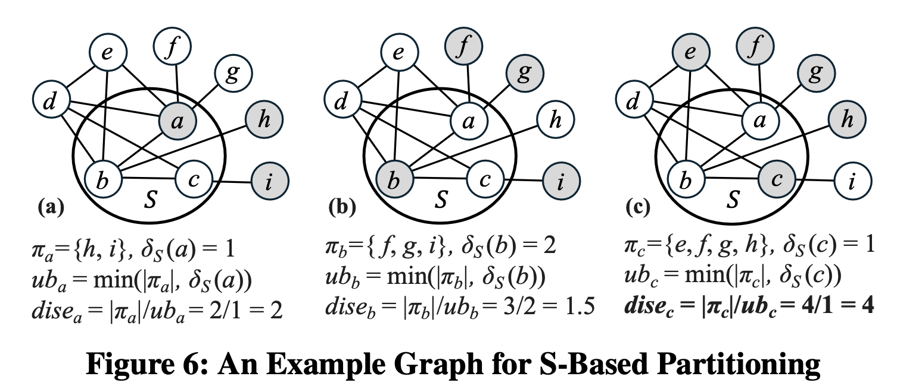
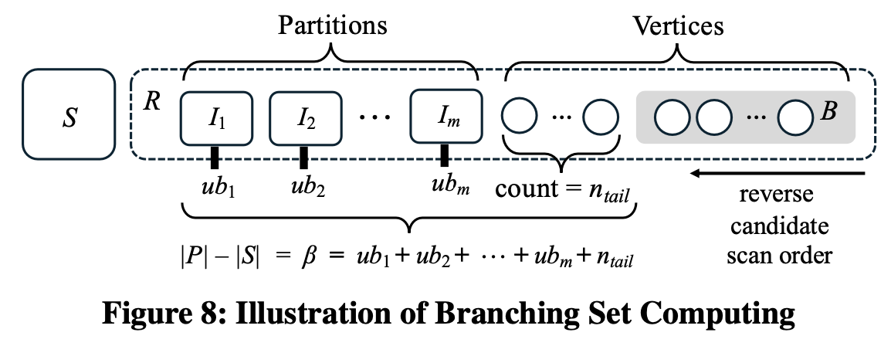

Slide 5
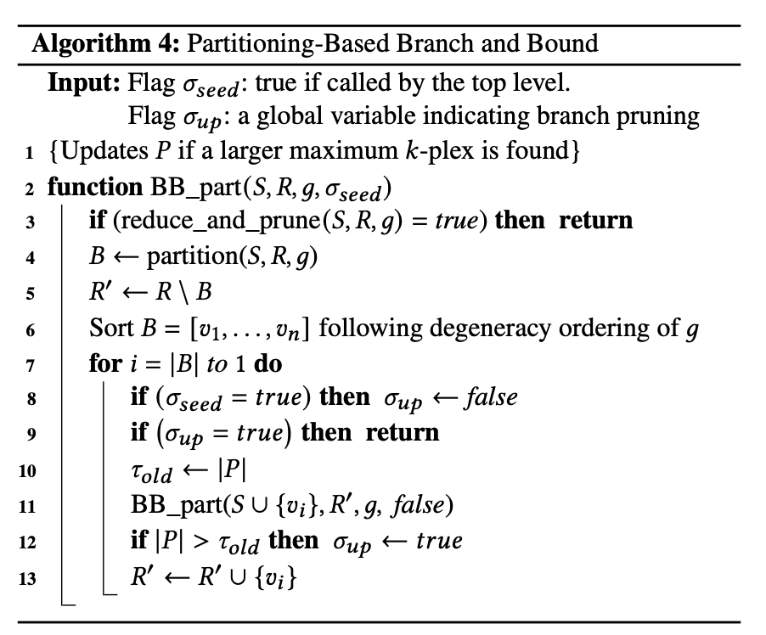








R
Cannot extend S larger than P
$$v_{|B|}$$
$$v_{2}$$
$$v_{1}$$
B
$$R_{B}^{′}$$
$$R_{B−1}^{′}$$
$$R_{1}^{′}$$
d alone cannot provide larger k-plex
{a}
{a, d}
{a, c}
{a, b}
{a, c, d}
{a, b, d}
{a, b, c}
{a, b, c, d}

Slide 6
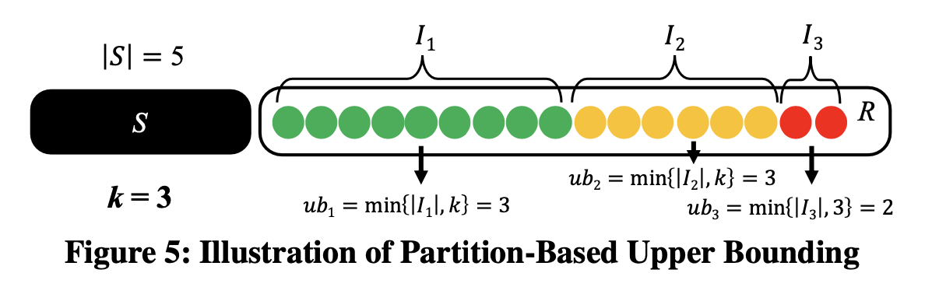
R-Based Partition

Slide 7
Solutions
UMkP-S
UMkP-R
UMkP-P
UMkP+-S UMkP+kPEX techniques
UMkP+-R
UMkP+-P
kPEX
kPEX-S
kPEX-R
kPEX-P

Slide 8
Thee Design Dimensions
Data structure: (1) sparse vectors for set reuse during backtracking; (2) dense bitmap
AltRB (and 2 other techniques) is enabled or not (for dense, we always use AltRB)
Branching method: R-based, S-based, pivot-based, and kPlex’s binary for dense only

Slide 9
Decision Tree
sparse
dense (always AltRB)
AltRB
No-AltRB
kPEX (kPex’s binary)
kPEX-S
kPEX-R
kPEX-P
UMkP+-S
UMkP+-R
UMkP+-P
UMkP-S
UMkP-R
UMkP-P

Slide 10
Scheme 1
One classifier, with classes being the 10 leaves
sparse
dense (always AltRB)
AltRB
No-AltRB
kPEX (kPex’s binary)
kPEX-S
kPEX-R
kPEX-P
UMkP+-S
UMkP+-R
UMkP+-P
UMkP-S
UMkP-R
UMkP-P

Slide 11
Scheme 2
A hierarchy of classifiers
  5 classifiers
  For each classifier, the ground truth is decided by the fastest leaf
Binary classifier
sparse
dense (always AltRB)
Binary classifier
Ternary classifier
(4-class)
AltRB
No-AltRB
kPEX (kPex’s binary)
kPEX-S
kPEX-R
kPEX-P
Ternary classifier
Ternary classifier
UMkP+-S
UMkP+-R
UMkP+-P
UMkP-S
UMkP-R
UMkP-P

Slide 12
Scheme 3
A hierarchy of classifiers
  3 classifiers
    shared ternary classifier
    For sparse, we skip kPEX (kPex’s binary)
      If kPEX (kPex’s binary) is the highest class, pick the 2nd highest
Binary classifier
sparse
dense (always AltRB)
Binary classifier
Ternary classifier
AltRB
No-AltRB
kPEX (kPex’s binary)
kPEX-S
kPEX-R
kPEX-P
Ternary classifier
Ternary classifier
UMkP+-S
UMkP+-R
UMkP+-P
UMkP-S
UMkP-R
UMkP-P

